Slide 1
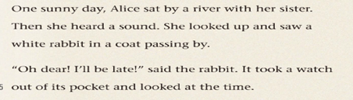
Task 1: Read Para. 1&2 and answer the questions.
1
2
Where did Alice see a white rabbit?
What did the rabbit say?
What was the rabbit going to do? Can you guess?
By a river.
It said, “Oh dear! I’ll be late!”
Open.

Slide 2

Task 2: Read Para. 3 and answer the questions.
1
3
2
1. Where did the rabbit go?
2. What did Alice do then?
3. Why did she do that?
4. If you saw such a rabbit, would you follow it like Alice did?
It jumped down a big hole.
She jumped down the big hole too.
Because she didn’t want to let the rabbit get away.
Open.

Slide 3
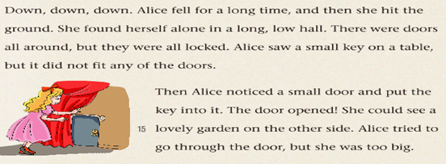
Task 3: Read Para. 4&5 and complete the chart.
There were doors all around, | BUT
Alice saw a small key on a table,
Alice saw a lovely garden on the other side, and tried to go through the door,
they were all locked.
it did not fit any of the doors.
she was too big.

